Slide 1
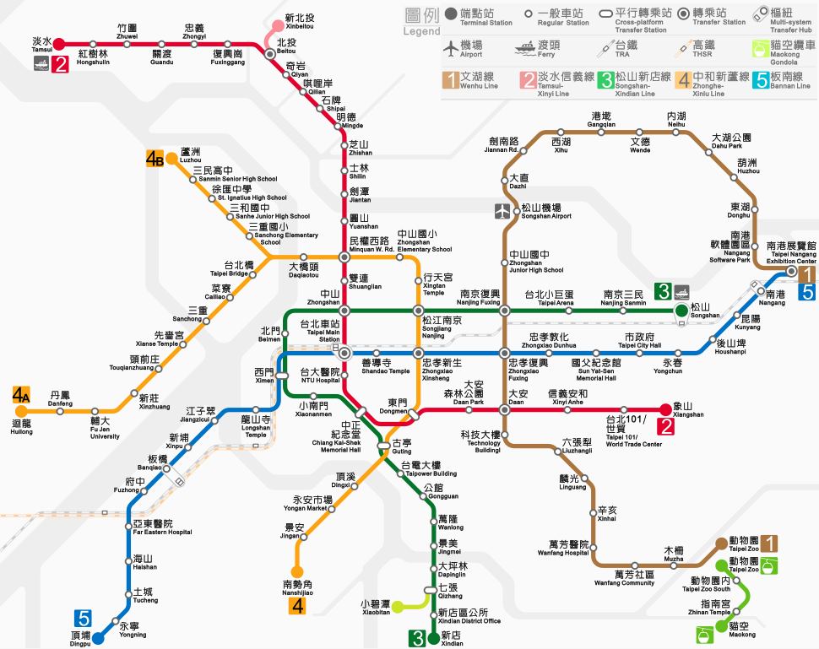

Using Econometric Modeling to Assess the Impacts of Rail Infrastructure on Air Quality
ECON-570, Fall 2024 Final Project, Group 2
Bruna Mendes, Mia Fong, You-seok Hur, Ibukunoluwa Kolade, Effie Li

Slide 2
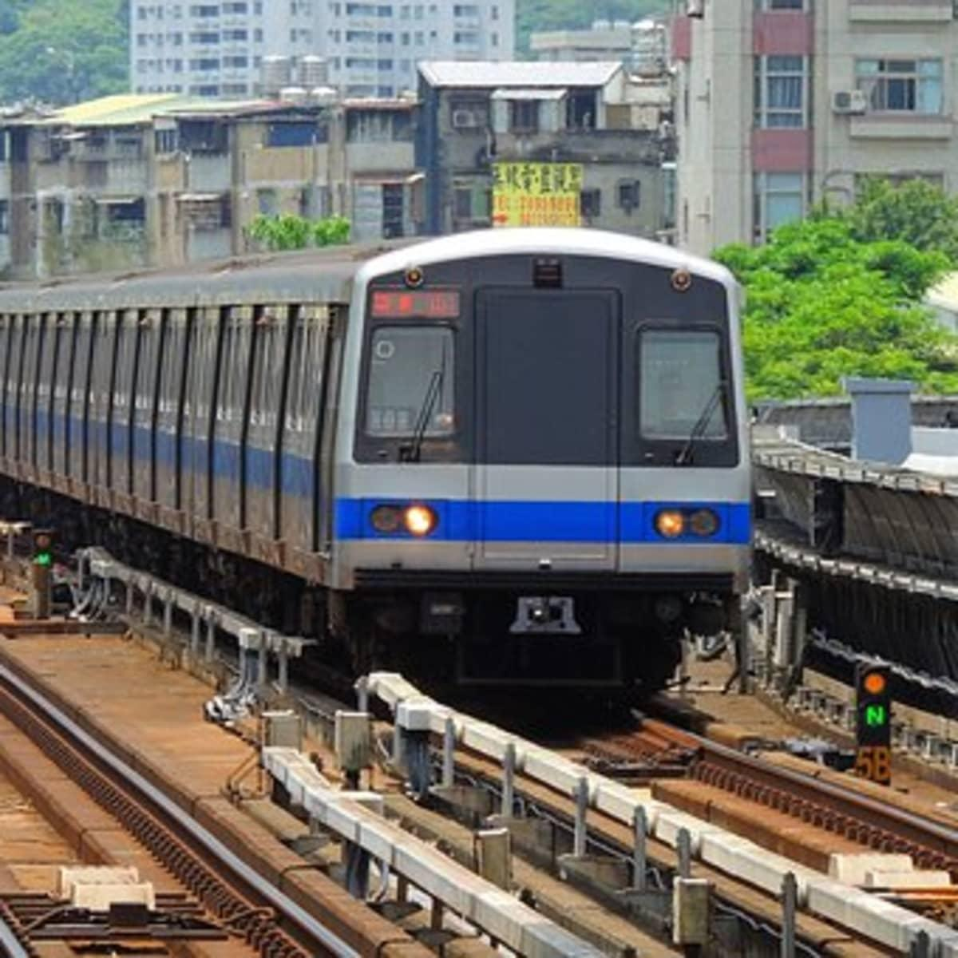
Presentation Overview
Introduction
  Background and research question
Study
  Introduction to the paper of interest
About the Data
Methods & Results
Ideas & Next Step

Slide 3




Introduction
The majority of air pollution (CO2, NOX) comes from…
Transportation
Industrial Act.
Electricity Gen.
Buildings
Main Research Question:
“The Effect of Introducing a Public-Transportation over Air Pollution”

Slide 4
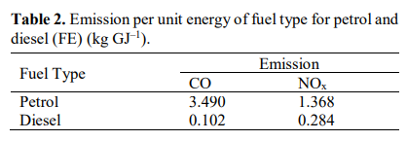
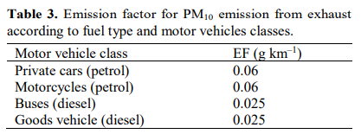
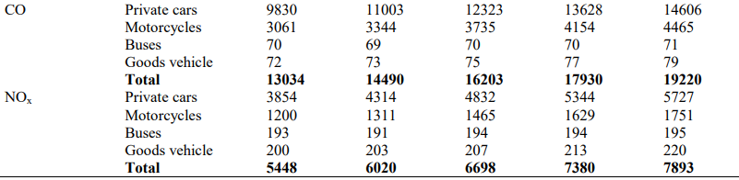
Introduction
Automobiles do play a large role in making Air Quality worse… (Shafie & Mahmud, 2020)

Slide 5
Introduction
So, does introducing effective ‘Public Transportation’ leads to a decrease in
generating Air Pollution materials?
Mohring (1972) | Ridership increases engender higher service frequencies, reduce the average waiting times at stops Investment in rail infrastructure divert marginal automobile travelers away from their vehicles
Vickrey (1969) | Investment in rail infrastructure simply increase demand for travel (Traffic Creation Effect) Diverting travelers away from automobile travel as well as inducing more travel ⇒ Unclear Effect!
Based on Chen & Walley (2015), we will further discuss the effects of transportation infrastructure on air quality.

Slide 6
2. Study of Interest
Chen and Walley (2012): “Green Infrastructure: The Effects of Urban Rail Transit on Air Quality”
Research Question
How does the development of rail transit infrastructure impact pollution levels in Taipei, Taiwan?
Identification problem: how to isolate the impact of rail transit infrastructure
Methods
OLS (estimate relationship between transit ridership and pollution over time)
Discontinuity-based (DB) OLS used to address bias issues
  Discontinuity: Opening of the Taipei Metro (March 1996)
Notes:
Mention that you will be vague here as the data will be discussed more in depth in the next section of the presentation
Interested in CO, NOx, and O3

Slide 7

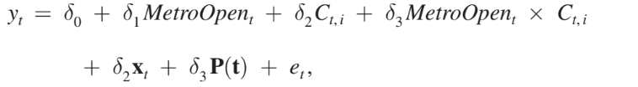
2. Study of Interest
OLS
DB OLS
DB OLS with
heterogeneous effects
The dependent variable (all models) is the log of air pollution (i.e. measurement of carbon monoxide, nitrogen oxides, and ground-level ozone)
The authors estimated the DB-OLS using a 2 year and 1 month window for air pollution (informative about expected pollution)
The parameters outlined in pink are of interest
Notes:
Key assumption: the only reason for air pollution to discontinuously change on Taipei Metro’s opening day is because of the opening of the Taipei Metro itself
Heterogeneous effects regression is what we’re the most concerned with (EJ effects, examines poverty characteristics)

Slide 8
2. Study of Interest
Key Takeaway: The opening of the metro rail led to a reduction in carbon monoxide ranging from 5 to 15 percent, although ozone wasn’t reduced significantly. These results suggest that new rail infrastructure can lead to air quality improvements (and this benefit should be considered when thinking about development).
Heterogeneous effects model: Commuters with cars did not alter their behavior significantly following the opening of the Metro
Our study expands and replicates this work. We recreated the heterogeneous effect regression and will utilize modeling techniques learned in class to see how results differ when model type changes.

Slide 9



3. Data
Hourly pollutants concentration measured across 16 monitoring stations
  CO, NOx, O3, PM10, SO2
Hourly weather variables
  Temperature, wind speed, humidity
Daily metro ridership
Gas regulations
Low income household share
Data Sources
Taipei Rapid Transit Company
Taiwanese EPA

Slide 10
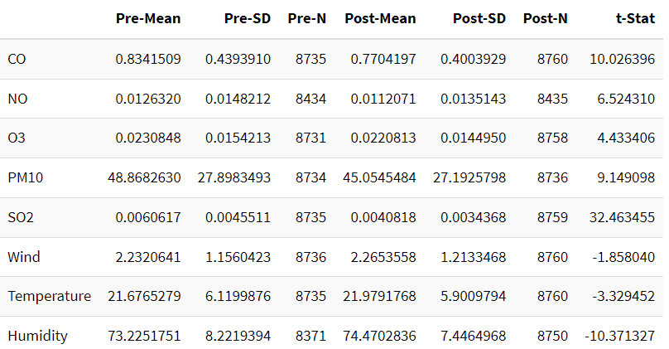
3. Data

Slide 11
4. Methods
In this project, we validate the results of this study through two avenues:
Placebo Tests
  Parameter of interest is 𝛿₃
  Algorithm based off of Causality II lecture
  Cutoffs are randomized
Lasso Regression
  Above model is high dimensional (over 200 parameters)
  Testing what factors are good predictors of pollution
Notes:
Parameter of interest is 𝛿₃
So whether the effects were different between low and high income areas. This was estimated to be zero by the researchers implying no heterogeneity
Algorithm based off of Causality II lecture
Estimate original Beta, estimate betas at different cutoffs, check if beta is statistically significant
Cutoff is randomized
This helps us assess the variance of our estimate and perform inference, while checking the continuity of our pollutants over time
In this project, we are validating the results of the original study through two key approaches—Placebo Tests and Lasso Regression—each serving a distinct purpose in ensuring the robustness and accuracy of the findings. Here's a detailed explanation of why both avenues are necessary and effective:
Placebo Tests:
Purpose: The goal of the placebo tests is to ensure that the observed effect of the urban rail transit system on air quality is genuine and not due to random variation or unobserved factors. By randomly shifting the timing or location of the intervention (the Metro opening), we can test whether similar pollution changes occur even when the treatment should not have had any impact.
Mechanism:
The parameter of interest in this case is 𝛿3, which captures the causal effect of the intervention (e.g., the opening of the Metro) on pollution levels. In the original study, this parameter is expected to show a significant change in pollution after the Metro opened.
The algorithm, based on the Causality II lecture, works by randomizing the cutoffs or treatment timing and applying the same regression discontinuity design (RDD). If the effect (𝛿3) is significant only when the correct treatment timing is used, it indicates that the Metro opening caused the pollution changes. If significant effects are also found at random cutoffs, it would raise concerns about the validity of the original finding.
Rationale: Placebo tests serve as a falsification check. If we find significant results when we randomize the timing of the intervention, it suggests that the original result might not be reliable. Conversely, if the randomized cutoffs show no significant effect while the true cutoff does, it strengthens the validity of the causal relationship between the Metro opening and air quality improvement.
Lasso Regression:
Purpose: The Lasso regression is used because the model in this study is high-dimensional—there are over 200 parameters being analyzed, including multiple pollutants, weather controls, and other regulatory factors. Lasso is an efficient tool for variable selection in such cases, helping to identify which factors are the most relevant predictors of pollution changes.
Mechanism:
Lasso regression works by applying a penalty to the size of the regression coefficients, shrinking less important variables' coefficients toward zero, and effectively selecting the most important predictors. In this context, Lasso allows us to test which factors—from the many parameters included—are truly significant in explaining changes in air quality.
This approach is critical when handling high-dimensional data because it simplifies the model, making it more interpretable while avoiding overfitting (where the model becomes overly complex and fits noise rather than the true signal).
Rationale:
In a model with over 200 parameters, traditional regression methods might struggle with multicollinearity and overfitting, making it difficult to identify which variables are truly driving the results. Lasso helps by narrowing down the variables to those that are statistically significant and meaningful predictors of pollution levels.
Additionally, Lasso allows us to handle the complexity of high-dimensional data without losing the ability to make accurate and interpretable inferences, making it a practical choice for a study that involves numerous control variables and potential confounders.
Why Use These Two Approaches Together?
Placebo tests provide external validation by ensuring that the observed effects are not due to random chance or biases in the model, helping us verify the causality of the intervention.
Lasso regression enhances the model’s internal validity by refining the selection of variables, ensuring that we’re focusing on the most critical factors that influence pollution, and avoiding the pitfalls of high-dimensional data.
By using both these avenues—placebo tests for robustness checks and Lasso regression for dimensionality reduction—we can more confidently validate the results of the original study and extend its findings with a higher degree of rigor and reliability.

Slide 12
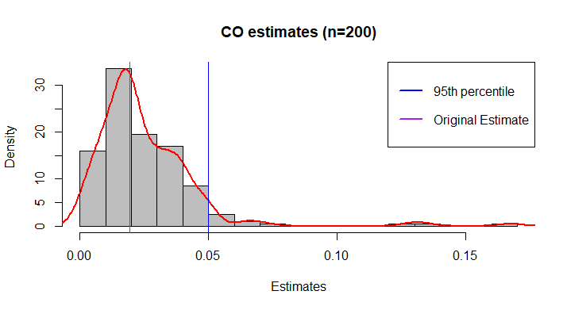
5. Results (Placebo Tests)
Notes:
Agrees with researchers
These are our results from the placebo tests on the Carbon monoxide regression. As you can see, the beta for our original estimate is well below the 95th percentile.

Slide 13
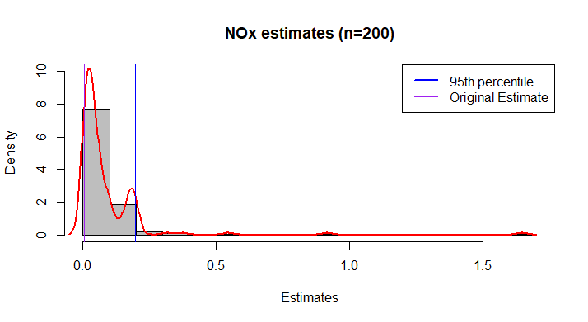
5. Results (Placebo Tests)
Notes:
Agrees with researchers
And as we can see here the same holds for the Nitrous Oxides. This adds weight to the researchers original result by showing a lack of discontinuity in our regressands, reinforcing the idea that the jump we see at the date of the metro opening is indeed caused by the new form of transportation and not another factor.

Slide 14
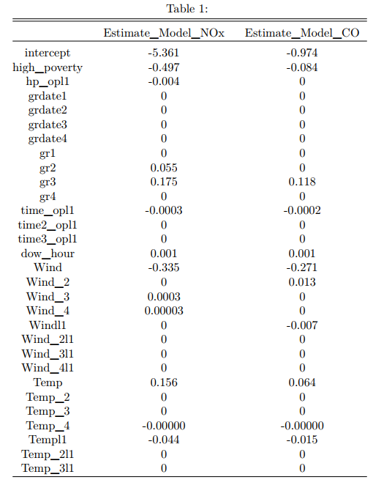
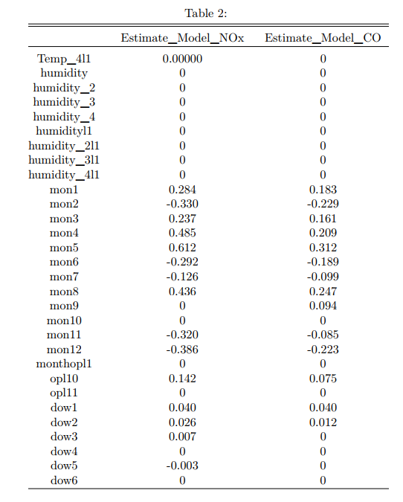
6. Results (Lasso)
Notes:
Here we have the results of the lasso regression. As we can see, both the income and presence of metro dummy variables are good predictors of pollutant levels which aligned with the researchers findings as those factors were significant. However, while the interaction term between the two is not present in the carbon monoxide regression, it is in the nitrous oxide variant. This challenges the researchers claims as they found no significant heterogeneity for either pollutant yet it remains a good predictor for one of them. It should be noted that there were other differences between the original model and our lasso on less important variables. For example, wind speed variables, days of the week and hours fixed effects were significant and good predictors while month fixed effects were generally not significant, yet appear to be good predictors.
Lasso generally agrees with RD OLS for CO, interaction shows up in lasso for NOx
Wind,days of the week,hours are significant, month is not but shows up in lasso

Slide 15
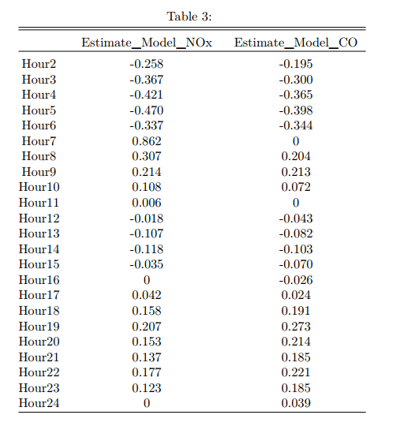
6. Results (Lasso)
Notes:
As we mentioned, hour fixed effects were s and they show up here as good predictors.

Slide 16
6. Results (Summary)
Placebo Tests show that there is no difference in the effect of the metro on pollution in high and low income areas.
The interaction between high poverty and the opening of the metro are good predictors of nitrous oxide but not carbon monoxide emissions.
  Challenges original conclusion
Notes:
In Placebo tests back up original result showing no difference in the effect of the metro between high and low income areas while the interaction between high poverty and the opening of the metro are good predictors of nitrous oxide but not carbon monoxide emissions challenging the original result.

Slide 17
7. Issues & Improvements
Issues | Improvements
Couldn't use CV due to RD approach | Lambda selection using CV with different model
Window choice was not data driven | ROT, sensitivity analysis etc
Controlled for opening and not activity of metro | Control for ridership instead of just opening
Data for sorting households was gotten from dates outside of sample dates | Obtain demographic data closer to sample
Heterogeneity may be different functional form | Divide areas into more than two groups
- | Using AICc instead of AIC to select clustering level
Notes:
So here are some issues and improvements we believe can be made to both the project and our work. We have a couple here that we believe are most important and should be focused on for the sake of time.
Window choice
2 year was picked because it balanced the tradeoff between less precise estimates due to small sample size and conceptual benefits of using data closer to cutoff. Controlling for seasonal variation in air pollution is hard with less than two years of data due to small sample size. They did also use 2 months as a validity check
Data for sorting households was gotten from dates outside of sample dates 2006
Demographic data was from 2006
Using AICc instead of AIC to select clustering level
Using AICc instead of AIC to select clustering level (not part of our project but something we thought would be interesting ). AICc is a good idea as it offers an extra penalty term to punish overfitting and for large sample sizes they converge to the same values anyway.

Slide 18
Thank you
Questions?

